Slide 1

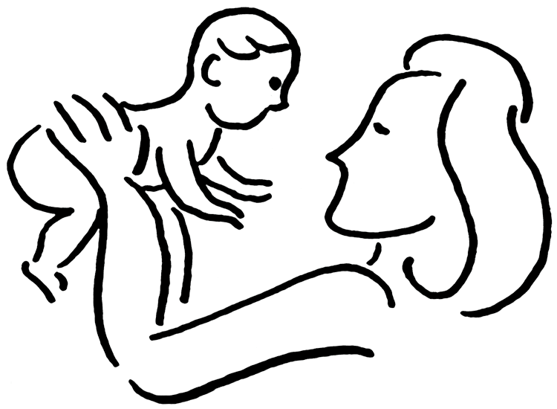
Maternal Depression Moderates the Relation between
Young Children’s Irritability and Later ADHD Severity
Martha Karran, Jennifer Valad, M.A., Gabriela Ventura, B.A., Jeffrey M. Halperin, Ph.D.
Department of Psychology, CUNY Queens College, Flushing, NY 11367
Abstract
Descriptive Statistics
Age 5 | Age 6 | Age 7 | Age 8 | Age 9
Objective: The prospective study assessed whether maternal depressive symptoms moderate the relation between parent-rated irritability and later ADHD severity. Methods: Maternal depression, as well as children’s irritability, was assessed twice, approximately one year apart when the children were 5-7 years old. Child irritability was assessed using parent ratings on selected items from the Behavior Assessment System for Children, Second Edition (BASC-2). Mothers reported their own level of depression using the Beck Depression Inventory (BDI). Mean scores for the two assessments were used as indicators for this study. Later ADHD severity was assessed using parent interview and teacher ratings when children were 8-9 years old. Multiple linear regression determined the extent to which Child Irritability (IV), Maternal BDI score (moderator), and the interaction term were predictive of ADHD severity at 8 and 9 years old. Results: Results indicated that both Child Irritability (β = 0.367, p < .001) and Maternal BDI score (β = 0.339, p < .001), as well as the interaction term (β = -0.225, p = .005), were significant predictors of later ADHD severity. Both high Maternal BDI score and high Child Irritability were associated with high ADHD severity. Additionally, the effect of Maternal BDI score on ADHD severity was greater when Child Irritability was low, compared to when Child Irritability was high. Conclusions: These data suggest that maternal depressive symptoms moderate the relations between early irritability and later ADHD severity. Future research may want to analyze teacher reports and further explore the bidirectional relations of maternal depression and childhood irritability over time.
N | Males | M_{age} at T1 | M_{age} at T2
160 | 118 (73.8%) | 6.31 (0.49) | 9.05 (0.38)
T1
T2
BASC-2
BDI
KSADS
 | Variable | Mean (SD) | Range
IV | Child Irritability | 1.12 (0.60) | 0-2.80
M | Maternal Depression | 7.05 (7.45) | 0-36
DV | ADHD Severity | 16.97 (11.75) | 0-36
Child Irritability Score
Maternal Depressive Score
ADHD Severity
Interaction Term
Results
Multiple Linear Regression
Maternal Depression
Background
β = 0.399, p < .001
Recent research has found that irritability in early childhood is associated with later psychopathology (e.g., depression, anxiety, ODD, and ADHD) (Dougherty et al., 2013).
Maternal depression has also consistently been found to be a potent predictor of later psychopathology in children (Cents et al., 2013; Lee et al., 2013).
However, it is unclear whether maternal depression influences the relations between early irritability and later psychopathology.
The present study looked at maternal depressive symptoms as a potential moderator of the relations between irritability and ADHD severity.
We hypothesized that maternal depression would have a significant impact on the relations between early irritability and later ADHD severity.
Interaction Term
ADHD Severity
β = -0.225, p = .005
Child Irritability
β = 0.367, p < .001
Interaction Effect
Methods
Maternal Depression Moderates the Effect of Early Child Irritability on Later ADHD Severity
The sample was derived from the Queens College Preschool Project (QCPP)—a longitudinal study investigating ADHD.
At two time points, one year apart, when the children were 5-7:
Mothers self-reported symptoms of depression using the BDI.
Parents completed a rating scale about their children’s behaviors and emotions (BASC-2).
When the children were 8-9 years old, ADHD severity was assessed using a semi-structured clinical interview with parents—supplemented by information from teachers and evaluators (KSADS).
Multiple linear regression was used to assess the relations between early irritability and later ADHD severity, and the moderating effect of maternal depression.
Maternal Depression
ADHD Severity
Irritability Subscale
Child Irritability
BASC-2 Items Used to Generate Irritability Score
Summary and Conclusions
Maternal depressive symptoms and child irritability are both predictive of later ADHD severity.
When child irritability is low, maternal depressive symptoms have a greater impact on later ADHD severity; whereas, when early childhood irritability is high, ADHD severity is high regardless of maternal depressive symptoms.
These findings indicate that, when treating children with ADHD, maternal depressive symptoms should also be considered.
Future research will analyze teacher reports and explore the bidirectional relations of maternal depression and child irritability over time.
Argues when denied own way
Is easily soothed when angry
Loses temper too easily
Is easily upset
Is easily annoyed by others
Average
Irritability
Score
Funding
This research was supported by grant # R01 MH068286 from NIMH.

